Slide 1
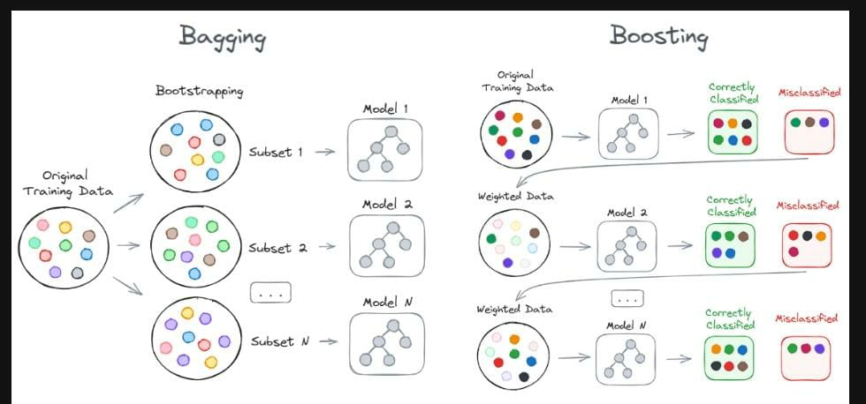

Boosting Algorithms
Machine Learning-Regression Algorithms
Types of Boosting
AdaBoost
XG Boosting
LG Boosting

Slide 2
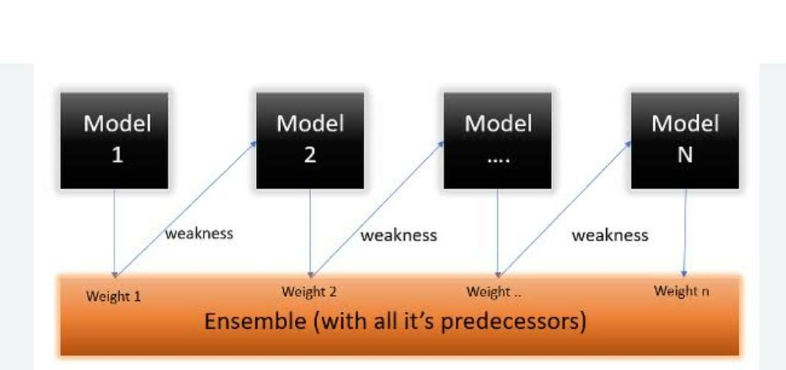
ADABoost
Machine Learning-Regression Algorithms

Slide 3
AdaBoost
Machine Learning-Regression Algorithms
Weight1,weight2,….weight n are the initial weights
Training data
Training data with updated weight
Training data with updated weight
Model 1
Model 2
Model n
Update Weight
Yes – Weight Decreased
No – Weight Increased
Update Weight
Update Weight
Yes – Weight Decreased
No – Weight Increased

Slide 4
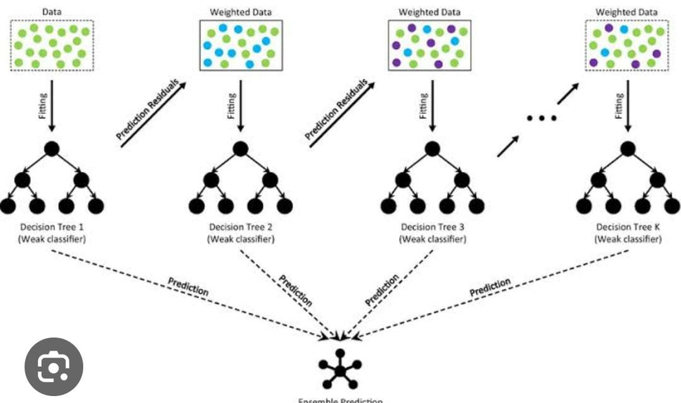
XG Boosting – Extreme Gradient Boosting
Machine Learning-Regression Algorithms
Designed to improve Speed and performance
Reliable and accurate predictive model
Regularization - avoid overfitting

Slide 5
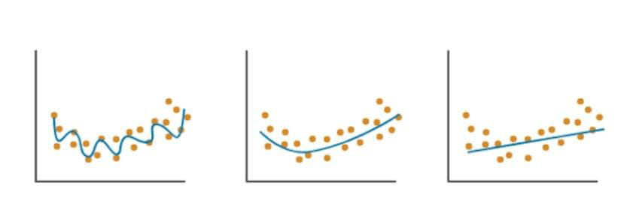

Machine Learning-Regression Algorithms XG Boosting – Regularization (adding penalty parameters L1,L2)
Overfit – high variance
in the data
Good Fit – low bias, low variance
Underfit – High bias

Slide 6
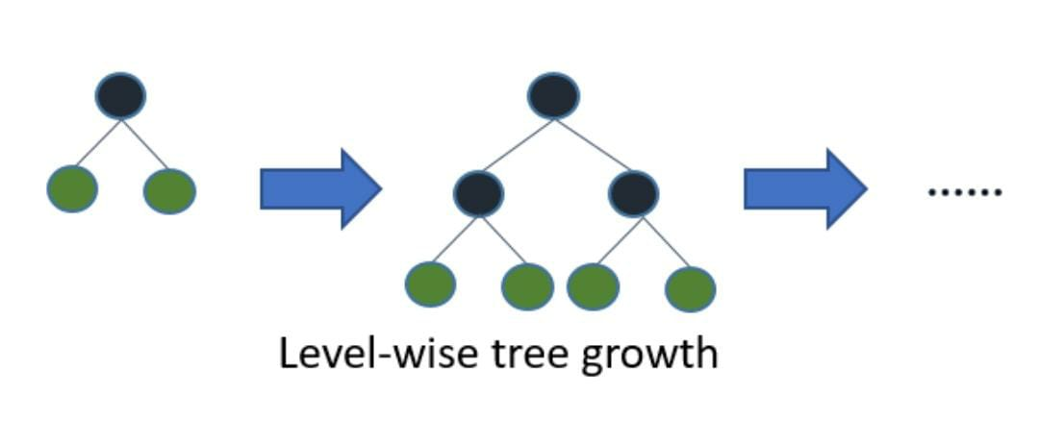
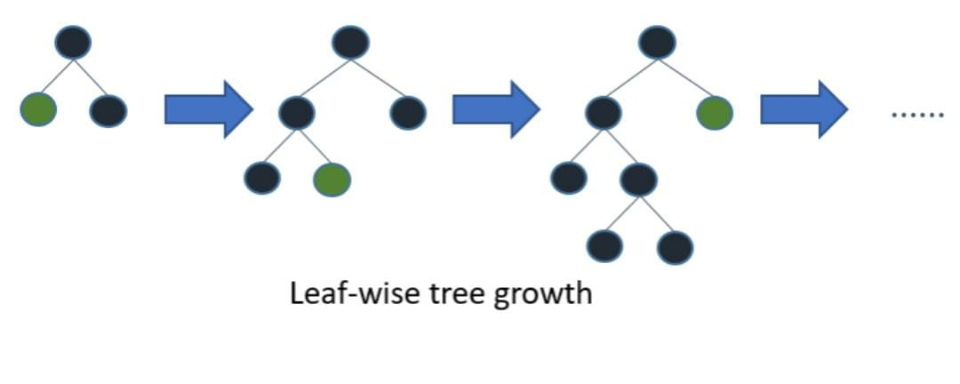
Machine Learning-Regression Algorithms LG Boosting ( Light GBM)
High speed (known as LightGBM)
Handles large dataset and takes low memory
Tree based learning algorithm
Grows tree vertically ( leaf-wise)
Selects the leaf with the maximum delta loss to grow

Slide 7
Thank You

